Slide 1
Java Methods, types of Java methods, recursion, calling methods, and examples

Slide 2
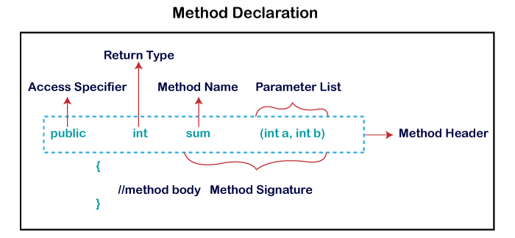
Java Methods
A method is a block of code or collection of statements or a set of code grouped together to perform a certain task or operation. It is used to achieve the reusability of code. We write a method once and use it many times. We do not require to write code again and again. It also provides the easy modification and readability of code, just by adding or removing a chunk of code. The method is executed only when we call or invoke it.
Method Declaration

Slide 3
Method Signature: Every method has a method signature. It is a part of the method declaration. It includes the method name and parameter list.
Access Specifier: Access specifier or modifier is the access type of the method. It specifies the visibility of the method. Java provides four types of access specifier:
Return Type: Return type is a data type that the method returns. It may have a primitive data type, object, collection, void, etc. If the method does not return anything, we use void keyword.
Method Name: It is a unique name that is used to define the name of a method. It must be corresponding to the functionality of the method. Suppose, if we are creating a method for subtraction of two numbers, the method name must be subtraction(). A method is invoked by its name.
Parameter List: It is the list of parameters separated by a comma and enclosed in the pair of parentheses. It contains the data type and variable name. If the method has no parameter, left the parentheses blank.
Method Body: It is a part of the method declaration. It contains all the actions to be performed. It is enclosed within the pair of curly braces.

Slide 4
types of Java methods
1) Predefined Method
In Java, predefined methods are the method that is already defined in the Java class libraries is known as predefined methods. It is also known as the standard library method or built-in method. We can directly use these methods just by calling them in the program at any point.
For ex. Such as print() method is defined in the java.io.PrintStream class.
2) User-defined Method
The method written by the user or programmer is known as a user-defined method. These method are modified according to the requirement.
public static void findEvenOdd(int num)
{
//method body
if(num%2==0)
System.out.println(num+" is even");
else
System.out.println(num+" is odd");
}

Slide 5
Recursion IN JAVA
EX:
public class RecursionExample1
{
static void p()
{
System.out.println("hello");
p();
}
public static void main(String[] args) {
p();
}
}
Recursion in java is a process in which a method calls itself continuously. A method in java that calls itself is called recursive method.
Syntax:
Returntype methodname()
{
//code to be executed
methodname(); //calling same method
}

Slide 6
Methods in java
1) Static Method
A static method belongs to the class rather than instances of the class. This means you can call a static method without creating an object of the class.
static methods can only directly access other static methods and static variables.
The keyword static is used to declare a static method.
public class MyClass {
public static void displayMessage() {
System.out.println("This is a static method.");
}
public static void main(String[] args) {
MyClass.displayMessage();
// No need to create an object
}
}

Slide 7
Methods in java
public class MyClass
{
public void displayMessage()
{
System.out.println("This is an instance method.");
}
public static void main(String[] args)
{
MyClass obj = new MyClass();
obj.displayMessage();
// Called through an object instance
}
}
2) Instance Method
An instance method belongs to an instance of a class (an object). You need to create an object to invoke an instance method.
These methods can access instance variables and other instance methods.
This keyword can be used within an instance method to refer to the current object.

Slide 8
Methods in java
public class MyClass
{
public void displayMessage()
{
String message = "This is a local variable."; // Local variable
System.out.println(message);
}
public static void main(String[] args)
{
MyClass obj = new MyClass();
obj.displayMessage();
// Call method that uses local variable
}
}
3) Local Method
Local variables are declared inside a method and only exist during the execution of the method.
These variables cannot be static, public, or protected.
They are destroyed once the method completes.

Slide 9
Calling methods
Calling Static Methods
A static method is associated with the class rather than any specific object.
You can call a static method directly using the class name without creating an instance of the class.
Calling Instance (Non-Static) Methods
An instance method is associated with an object of the class.
To call an instance method, you need to create an object (instance) of the class first.
Calling Methods from Other Methods
You can call a method from another method within the same class or from different classes. For instance, you can have a method that calls other helper methods:
Calling Methods with Return Values
You can store the result of a method in a variable
calling Methods with Parameters
If a method takes parameters, you must provide the required arguments when calling the method.

